Slide 1
INTEGRATED CAPSTONE PROJECT
PROJECT NAME : Marketing for Financial Services
PROJECT NAME : Marketing for Financial Services
BATCH : H
GROUP : H1
Sri Praveena Geddam(DELBC8001)
Hebbar Sumukh(DELBC8002)
Niyatee Nibedita Panda(DELBC8003)
Yogam Rakshana R(DELBC8004)
Ukash Bhat(DELBC8005)

Slide 2



Problem Statement
DB Bank is a large public sector bank which has branches across the cities. It provides various services like savings accounts, current account, term deposits, personal loans, home loans etc. to customers. Whenever the bank conducts marketing on its new schemes, it will keep track of data related to customers’ personal, social and economic details. Also, it maintains the detailing on efforts made to achieve success in the campaign.
Recently, the bank has conducted a campaign to market their term-deposit scheme. Campaigns was conducted based mostly on direct phone calls, soliciting the bank's customers to place a term deposit. After all the marking efforts, if the client had agreed to place a deposit, then the campaign is success, otherwise not.
The campaign success is needed to be measured based on appropriate predictive model for classifying successful and unsuccessful campaign.

Slide 3



CHALLENGE
SOLUTION
It is a challenge for bank officials to target right people for a successful campaign.
The marketing team must analyse various details like profession, income, age, education including the possibility of any existing loans, credit history etc will give economic status of the customer and hence helps in understanding whether the person is capable of depositing money into term-deposit scheme of the bank.
A Predictive Model for classifying data can be built, to efficiently analyze the data and ascertain the right target audience

Slide 4
Timeline
Capstone Project Walkthrough
18
Checkpoint 1
Submission
20
Checkpoint 3 Start
7
Start of Capstone Project
3
Final Presentation
October
November
December
20
Checkpoint 2 Start
15
Checkpoint 2 Submission

Slide 5







Building Steps of The Capstone Project
Step 5
Deploy the model
Step 4
Build a Machine Learning model
Step 3
Perform Exploratory Data Analysis
Step 2
Perform Data Manipulation on the dataset
Step 1
Read and understand the dataset.

Slide 6





Additional Functions of Capstone Project
Perform SQL Operations
Power BI analysis
Market Campaign Dataset
Statistical Analysis
Operations using PySpark
Cloud (Azure)

Slide 7


Data Dictionary
Data related to the last contact of the current campaign
Bank Client Data
Customer id : Unique customer id
custAge: Age of the customer.
profession: type of job
marital: marital status
schooling: Educational qualification
default: has credit in default?
housing: has housing loan?
loan: has personal loan?
State_Code: Code representing unique state name
Region_Code: Code representing unique Region name
City_Code: Code representing City of the customer
Postal_Code: Postal code of the area
contact: contact communication type
month: last contact month of year
day_of_week: last contact day of the week
campaign: number of contacts performed during this campaign and for this client
pdays: number of days that passed by after the client was last contacted from a previous campaign
poutcome: outcome of the previous campaign
Social and Economic context attributes
emp.var.rate: employment variation rate - quarterly indicator
cons.price.idx: consumer price index - monthly indicator
cons.conf.idx: consumer confidence index - monthly indicator
euribor3m: euribor 3 month rate - daily indicator
nr.employed: number of employees-quarterly

Slide 8
Python Packages used in the Project
Numpy: It is a Python library that provides a multidimensional array object, various derived objects and an assortment of routines for fast operations on arrays, including mathematical, logical, shape manipulation, sorting, selecting, I/O, discrete Fourier transforms, basic linear algebra, basic statistical operations, random simulation and much more.
Pandas: It is used for data analysis and machine learning tasks
Matplotlib: It is one of the most popular python package used for data visualization.
Seaborn: It is a library mostly used for statistical plotting in Python.
Scikit-learn: It is a free software machine learning library for the Python programming language.
Stats-model: This provides classes and functions for the estimation of many different statistical models, as well as for conducting statistical tests, and statistical data exploration.
Scipy: It is used for solving scientific, engineering and technical problems
PySpark: It is an interface for Apache Spark in Python.
Flask: It is a micro web framework written in Python. It is classified as a microframework because it does not require tools or libraries.

Slide 9



CHECKPOINT-1

Slide 10



Checkpoint-1 Walkthrough
1
2
3
Data Manipulation using Python
SQL -Oracle
Statistical Analysis using Python

Slide 11

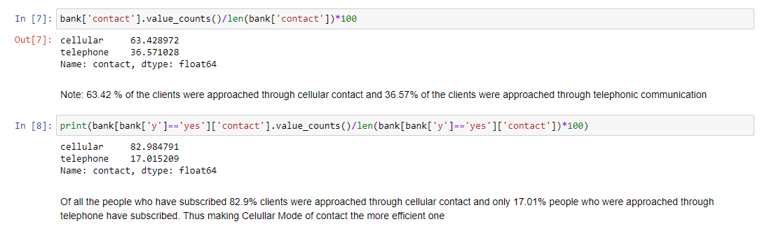

Task 1.1 – Data Manipulation using Python
Right Mode to contact the customers (Telephone or Mobile)
1. Percentage analysis of all customers.
2. Percentage analysis of customers who subscribed for the term deposit.

Slide 12
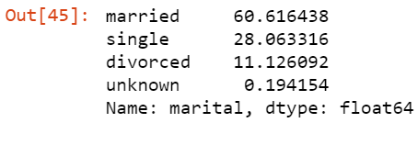
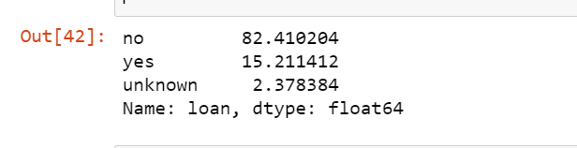
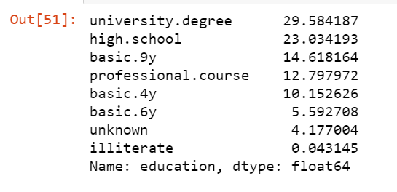
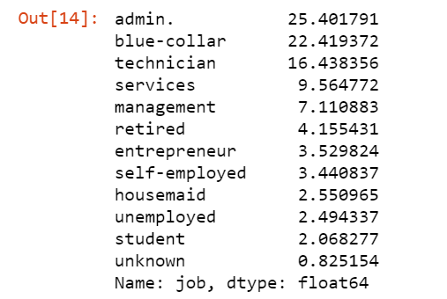
Personal data analysis on marital status, existing loans, education, profession etc.
Percentage Analysis of Marital Status
Percentage Analysis of existing loans
Percentage Analysis of Education
Percentage Analysis of Profession

Slide 13
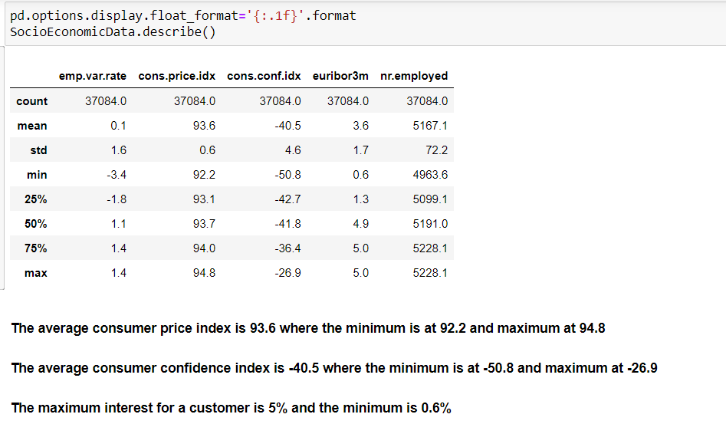
Socio-Economical analysis of the customers

Slide 14
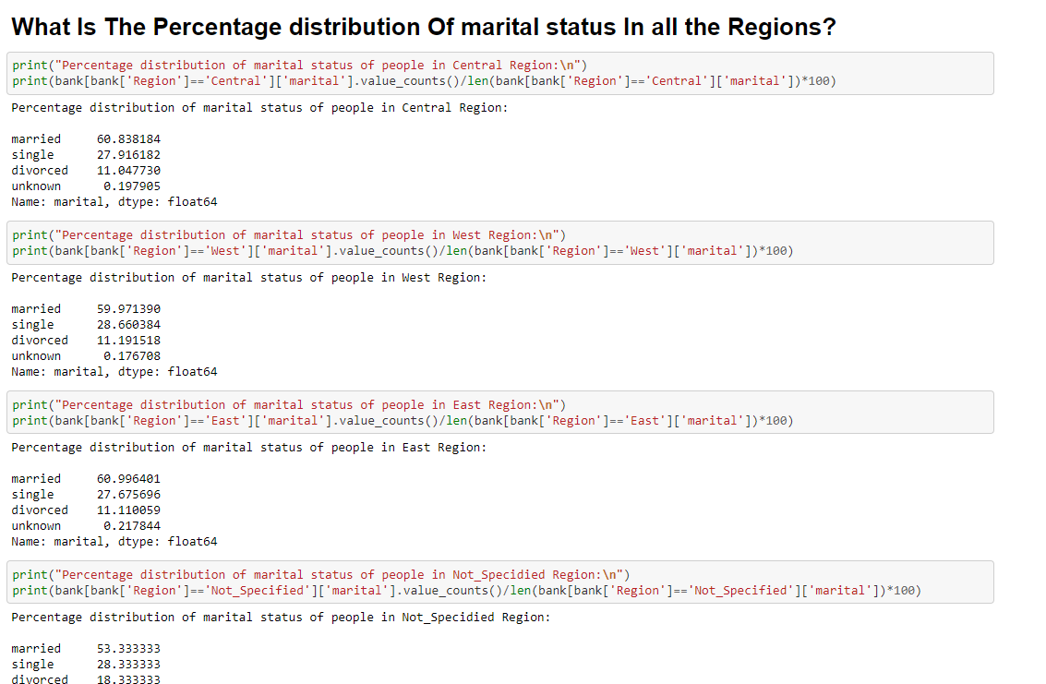
Demographic analysis of the marketing campaign using the master files
The Region of customers is not affecting the marital status, as in all the regions the percentage distribution of marital status is nearly same.
The result of analysis is same for all the columns such as job, education, contact etc. with respect to Region of customers.

Slide 15
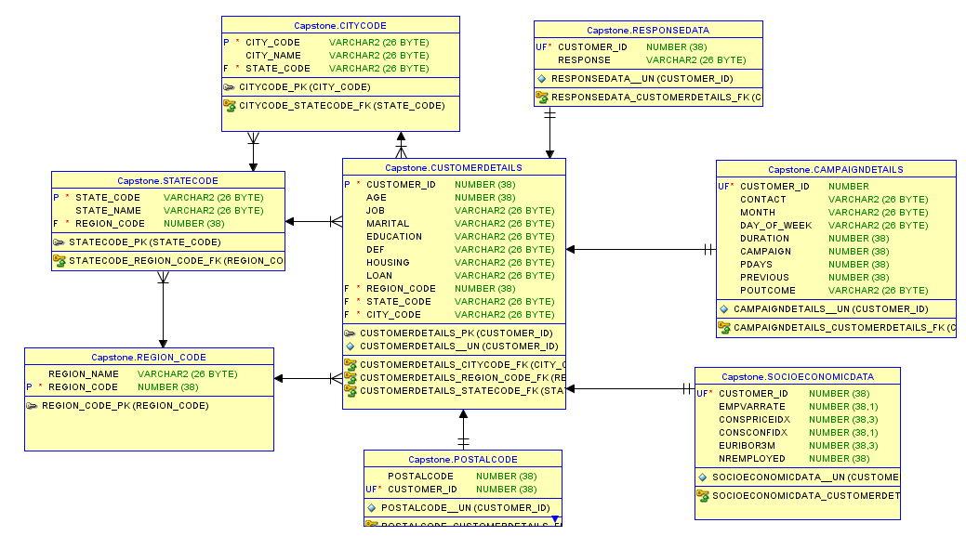
TASK 1.2 – SQL – Oracle
Construct an ER-Diagram
The "customerdetails" has "Many to One" relationship with "citycode" , "statecode" and "region_code" tables.
The "responsedata" , "campaigndetails" , "socioeconomicdata" and "postalcode" tables have "One and Only One" relationship with the "customerdetails" table.

Slide 16
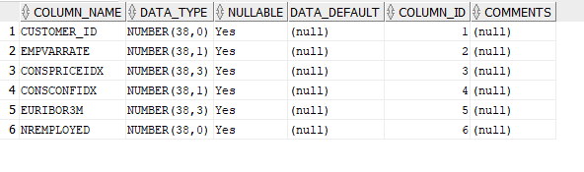
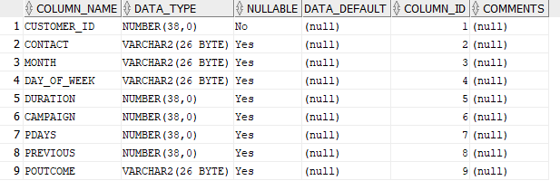
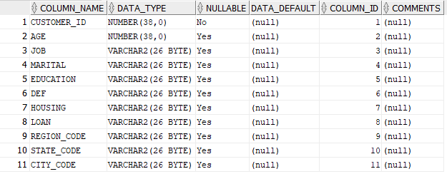
Creation of tables as per ER-Diagram
Socio-economic Data Table
Campaign Details Table
Customer Details Table

Slide 17
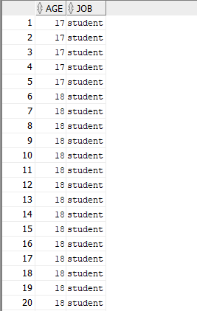
Generate the list of customer has per age and profession and display them according to ascending order of the age.
Selecting “AGE”, “JOB” columns from the table CUSTOMERDETAILS order by “AGE” to get the output in ascending order.

Slide 18
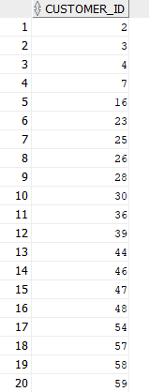
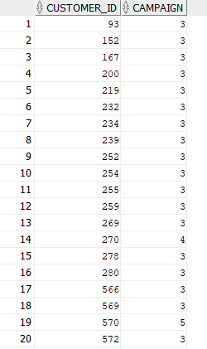

Generate the list of customer who have no housing loan and personal loan.
Generate the list of customer who has credit and has been contacted more than 2 times during the campaign.
Selecting the list of customers (column : “customer_id”) who have no housing loan or personal loan.
Selecting the “customer_id”, “campaign” rows from the joint table of customerdetails and campaigndetails with the above stated conditions.

Slide 19
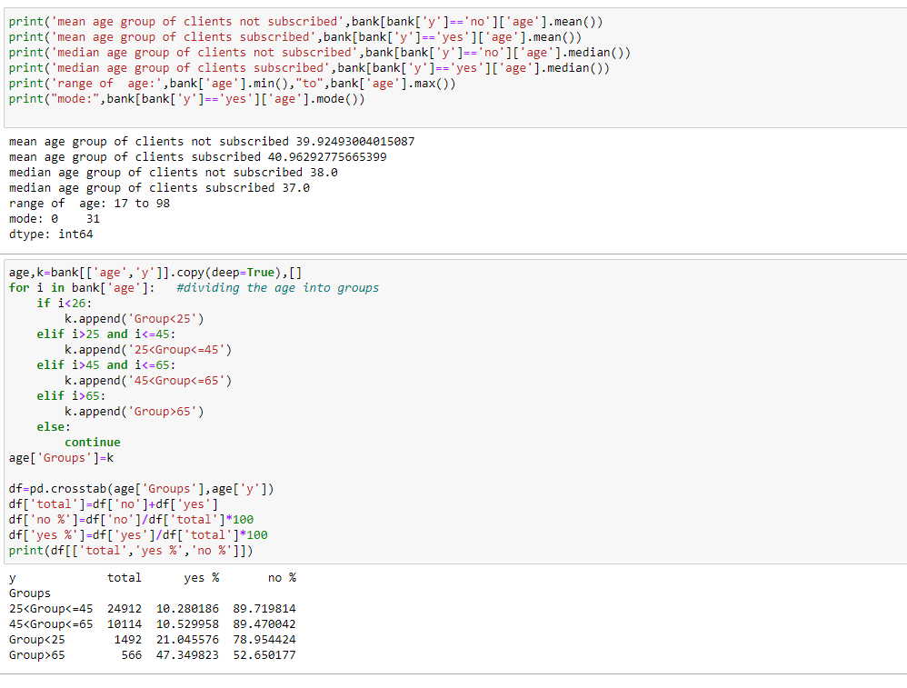
TasK 1.3 – Statistical Analysis using Python
Descriptive statistics for both numerical and categorical and draw few insights from them.
We can infer that, The mean age irrespective of subscription and is around 40 years.
And there are a greater number of customers in the group of 25 to 45 years

Slide 20
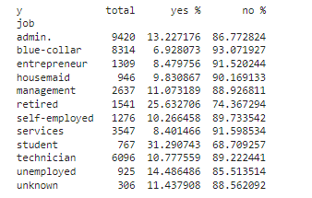
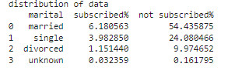
TasK 1.3 – Statistical Analysis using Python
The most frequent profession type is admin irrespective of subscription
The most frequent Marital status is married irrespective of subscription

Slide 21
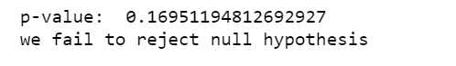
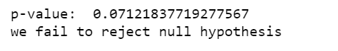
Perform relevant hypothesis testing (z test, chi-Square)
Null Hypothesis : Average age of the customer is 40 years
Alternative Hypothesis : Average age of the customer is not 40years
Output: -
One Sample Z-test
Null Hypothesis : There is no difference in the mean ages of customers who agreed and not agreed to the term deposit
Alternative Hypothesis : There is a difference in the mean ages of customers who agreed and not agreed to the term deposit
Output: -
Two Sample Z-test

Slide 22
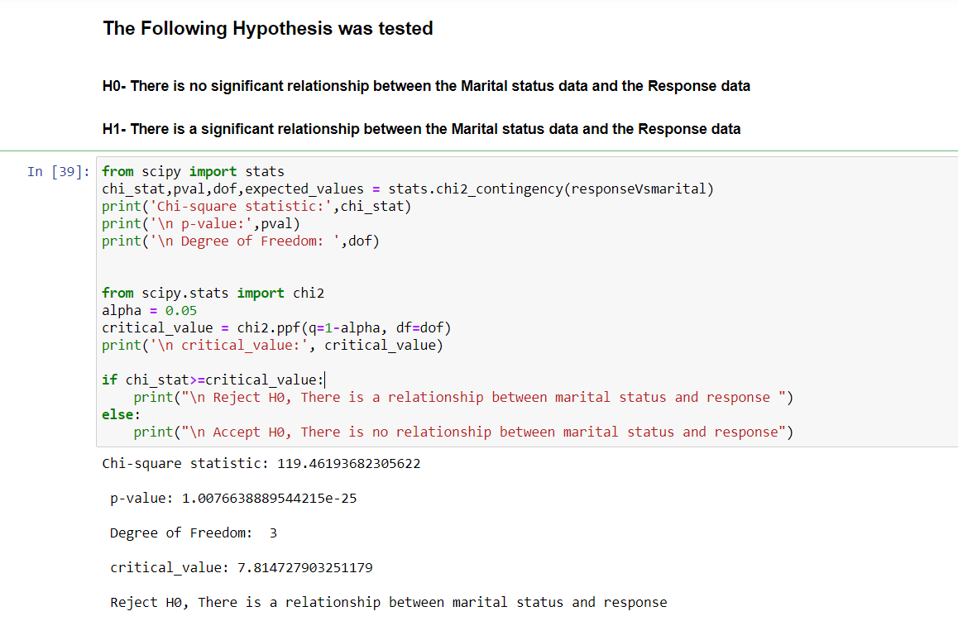
Chi-Square Hypothesis Test
Null Hypothesis (H0) : There is no significant relationship between the Marital status and the Response Data
Alternative Hypothesis (H1) : There is significant relationship between the Marital status and the Response Data
Output: -

Slide 23
ChECKPOINT-2

Slide 24
Checkpoint-2 Walkthrough
1
Visualization using Python
3
Power BI Visualization
2
Exploratory Data Analysis
Model Building using Machine Learning Algorithms
4

Slide 25

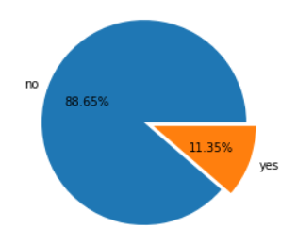
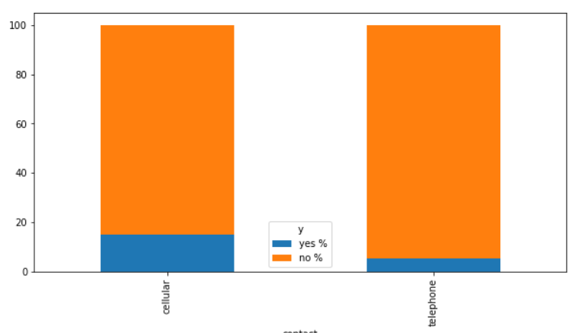
Task 2.1 - Visualization using Python:
Analysis of percentage turnout
Right mode to contact the customers
From the graph, we can see that the percentage turnout of the marketing campaign is 11.35%
Making Cellular Mode of contact is clearly the more efficient one.

Slide 26
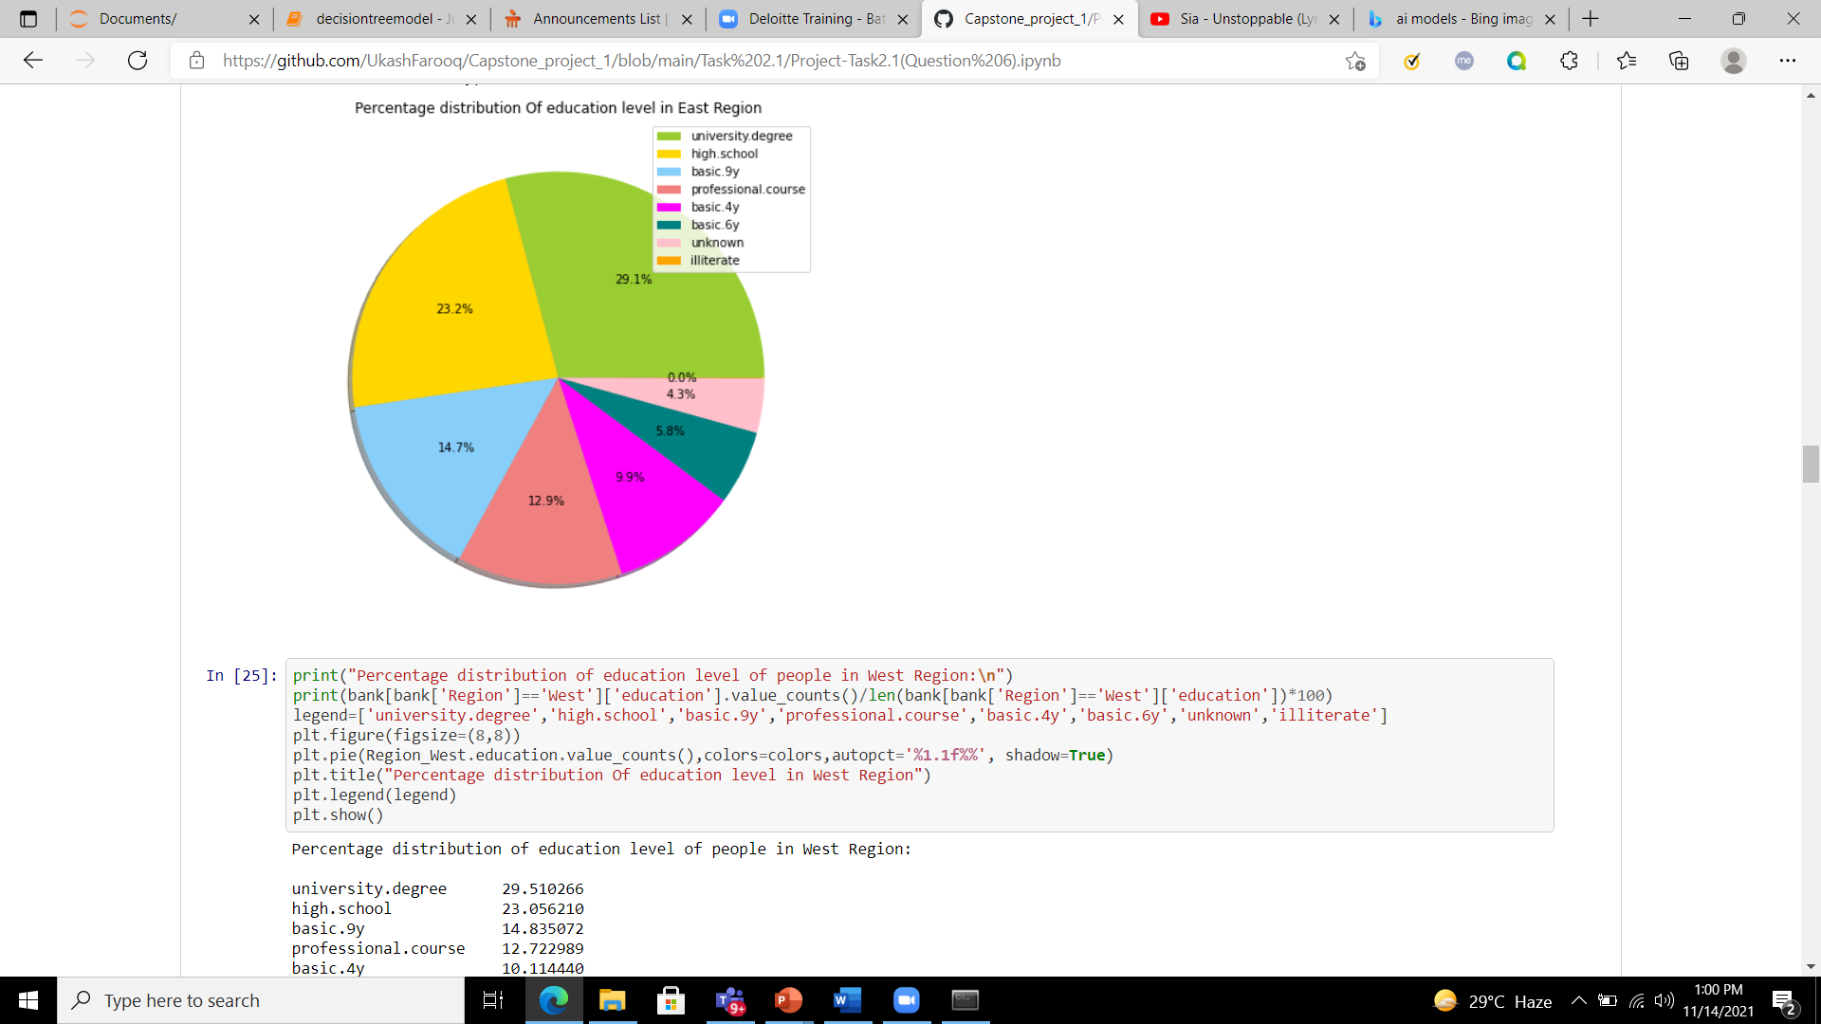
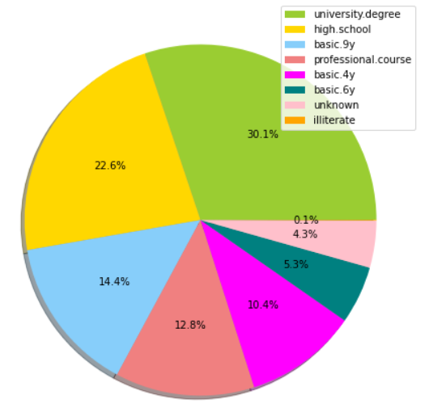
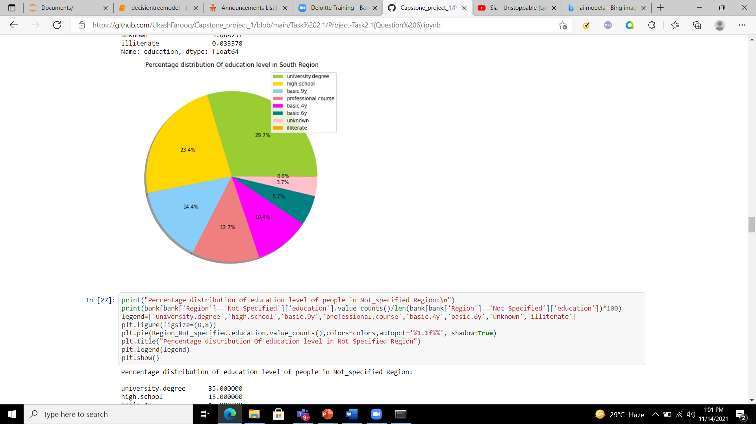
Percentage Distribution of Education in different Regions:
Central Region
East Region
South Region

Slide 27

01
06
Univariate and Bivariate Analysis
Feature Selection
T
A
S
K
2.2
02
05
Missing value identification
Exploratory Data Analysis
Data Transformation
03
04
Outliers' treatment
Data Scaling/Normalisation

Slide 28
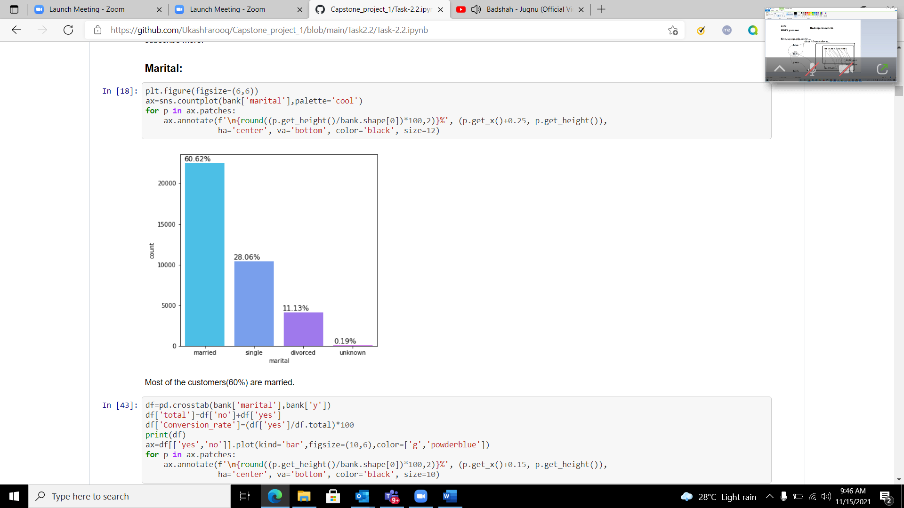
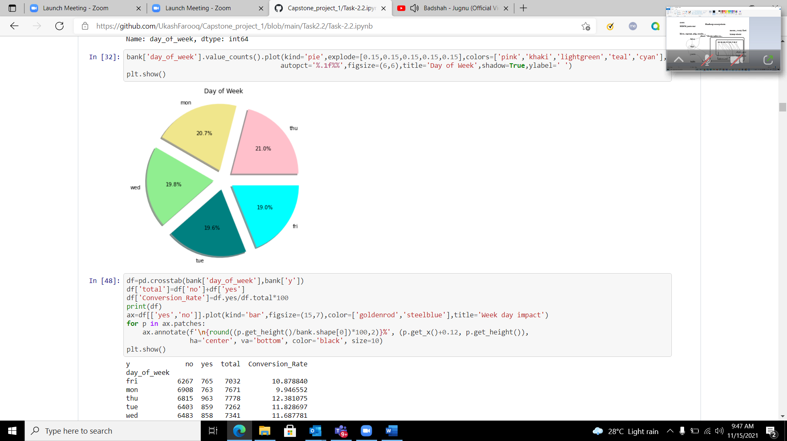
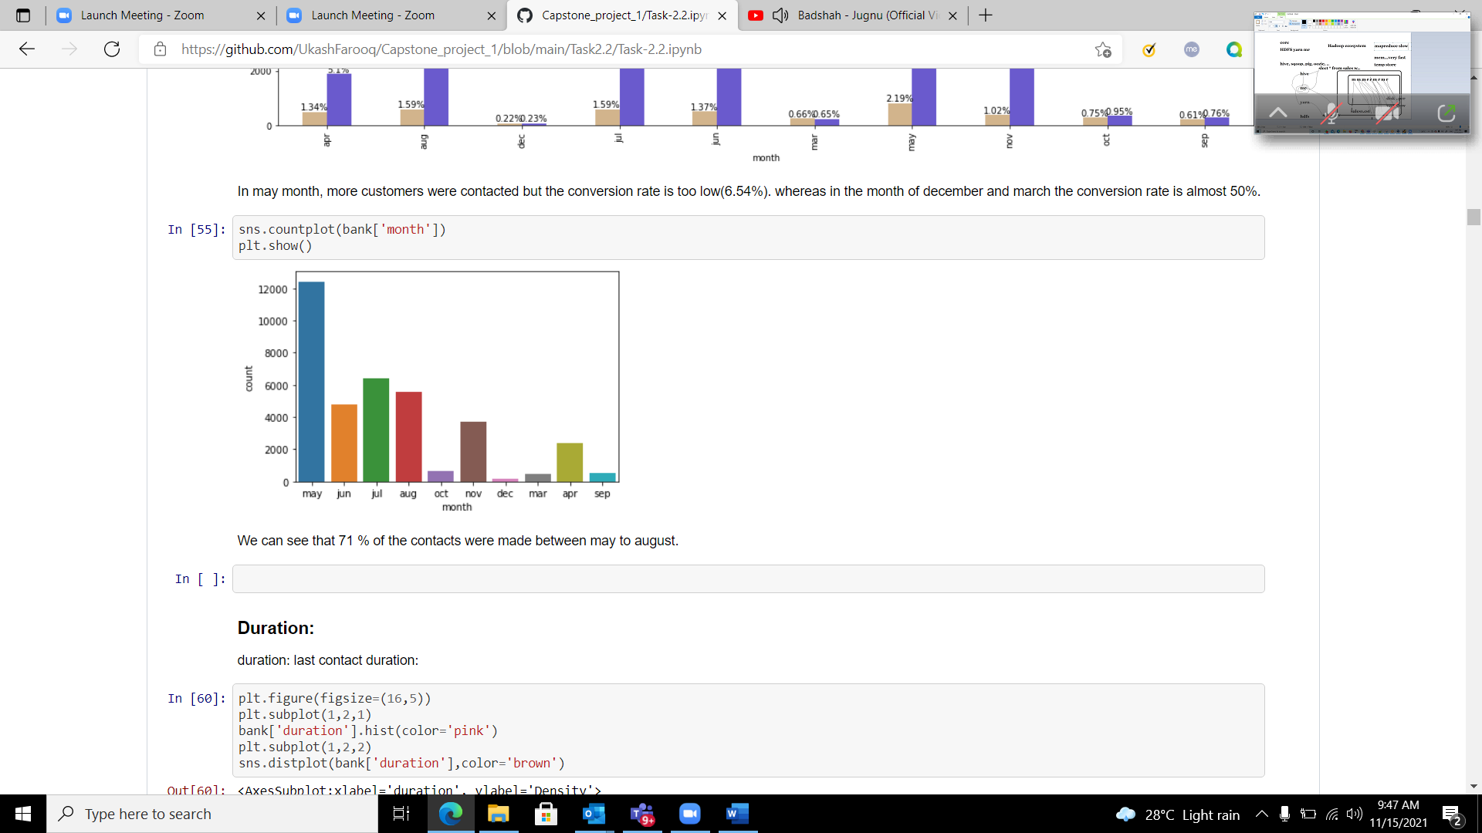
Task 2.2 – Exploratory Data Analysis Univariate Analysis
Month-wise distribution
Marital data
Days-of-Week
Most of the customers(60%) are married.
There is a nearly equal distribution of data in all weekdays
We can see that 71 % of the contacts were made between may to august.

Slide 29



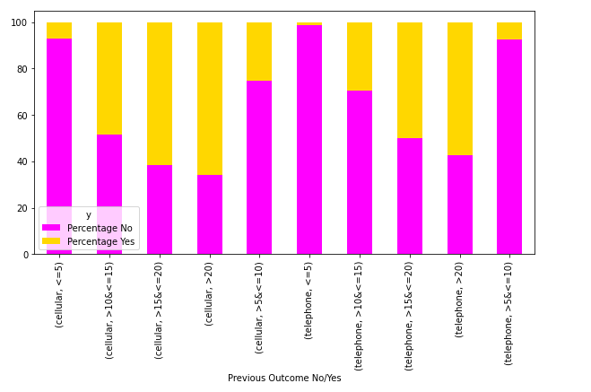


Bi-Variate Analysis
We can see that when customers are contacted through telephone for a duration of less than 5 minutes the conversion rate is low.
On the other hand, when contacted via cellular for more than 20minutes, the customer tends to opt the deposit.

Slide 30
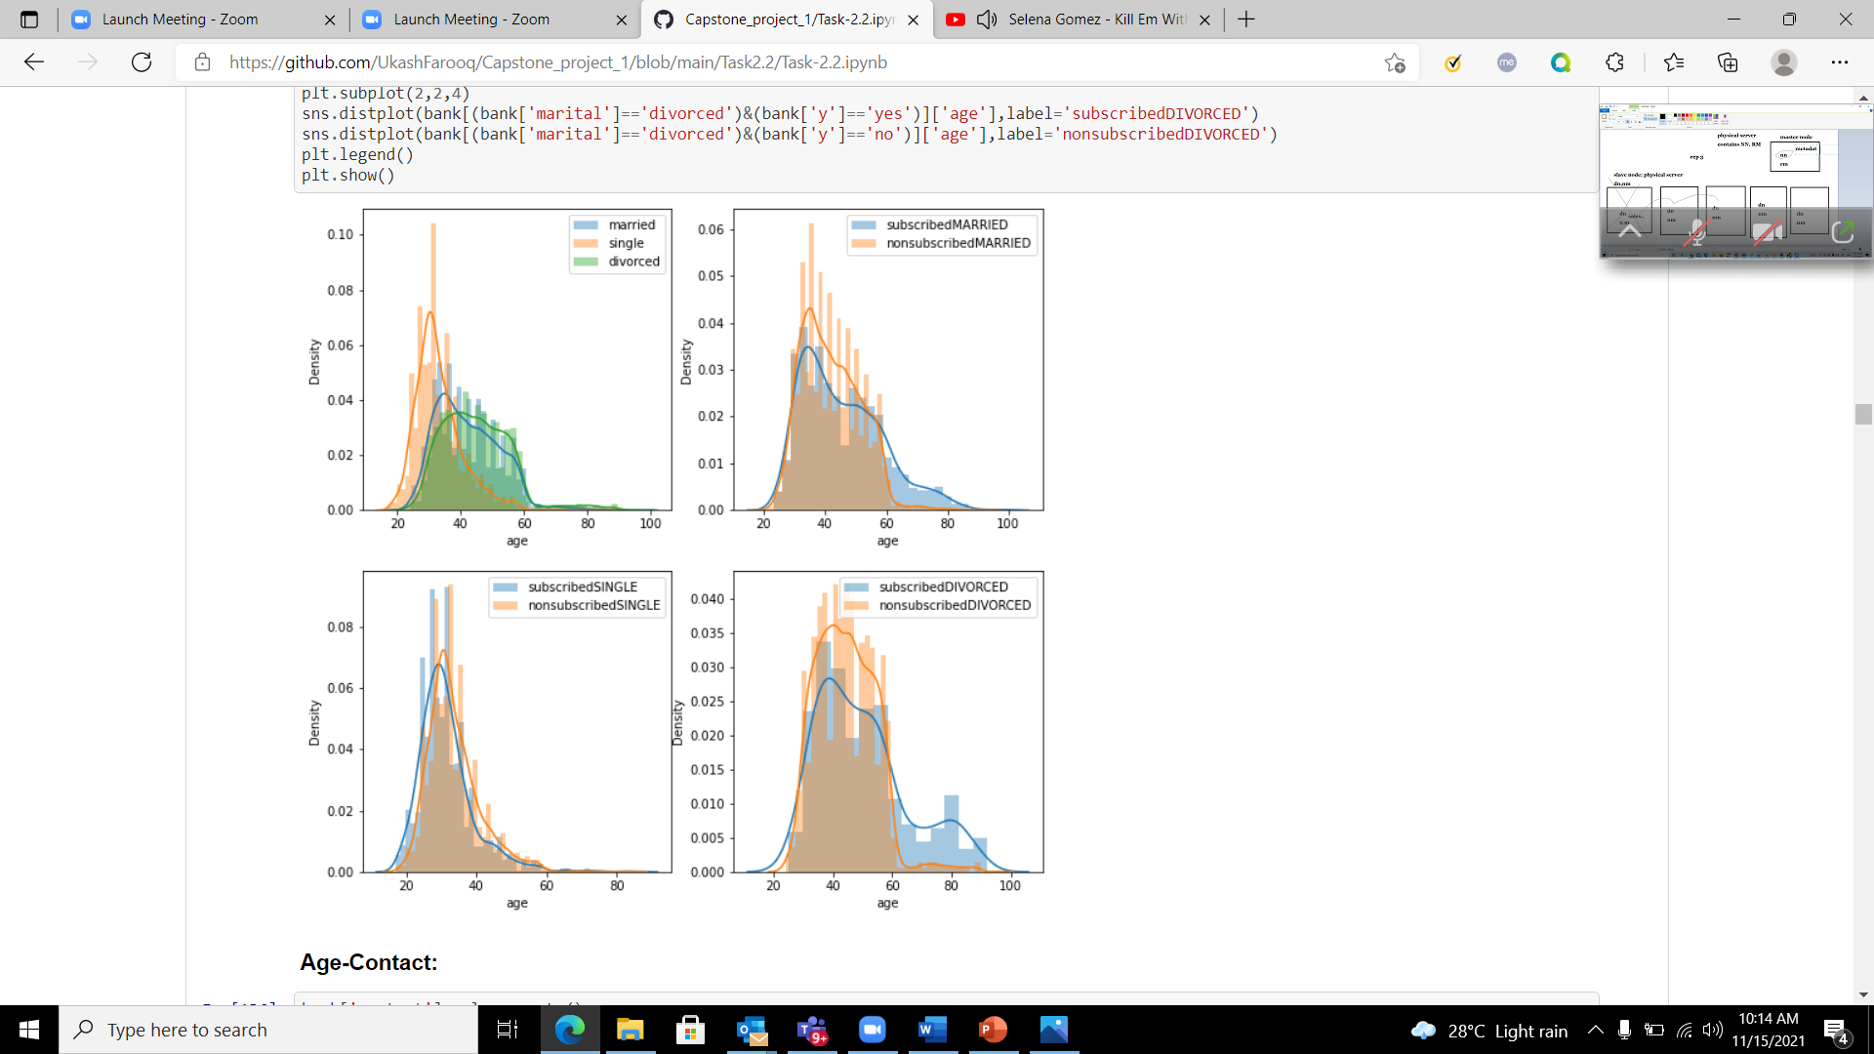
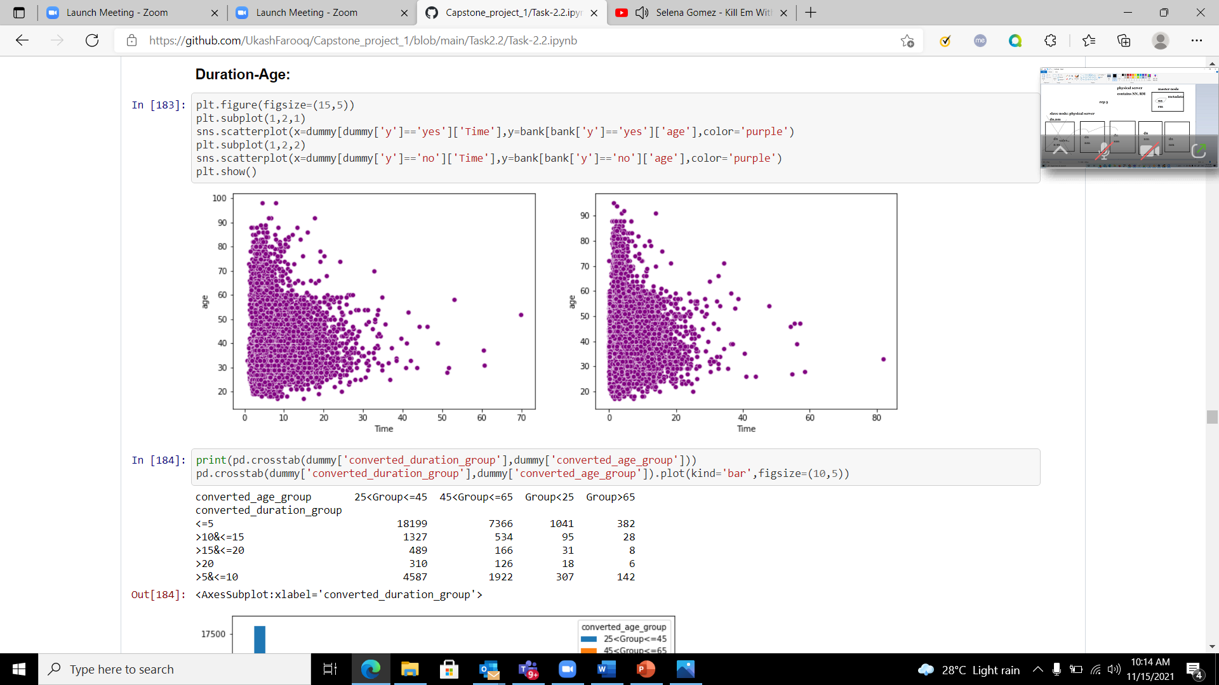
Multivariate Analysis
Density plot for marital status - age
Scatter plot for duration-age
yes
no

Slide 31
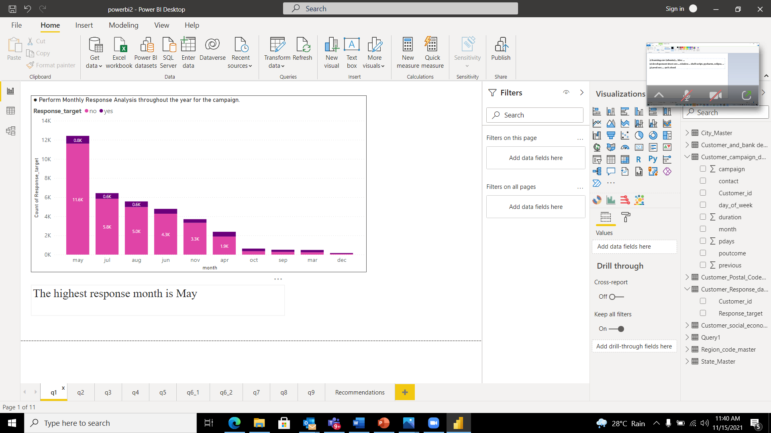
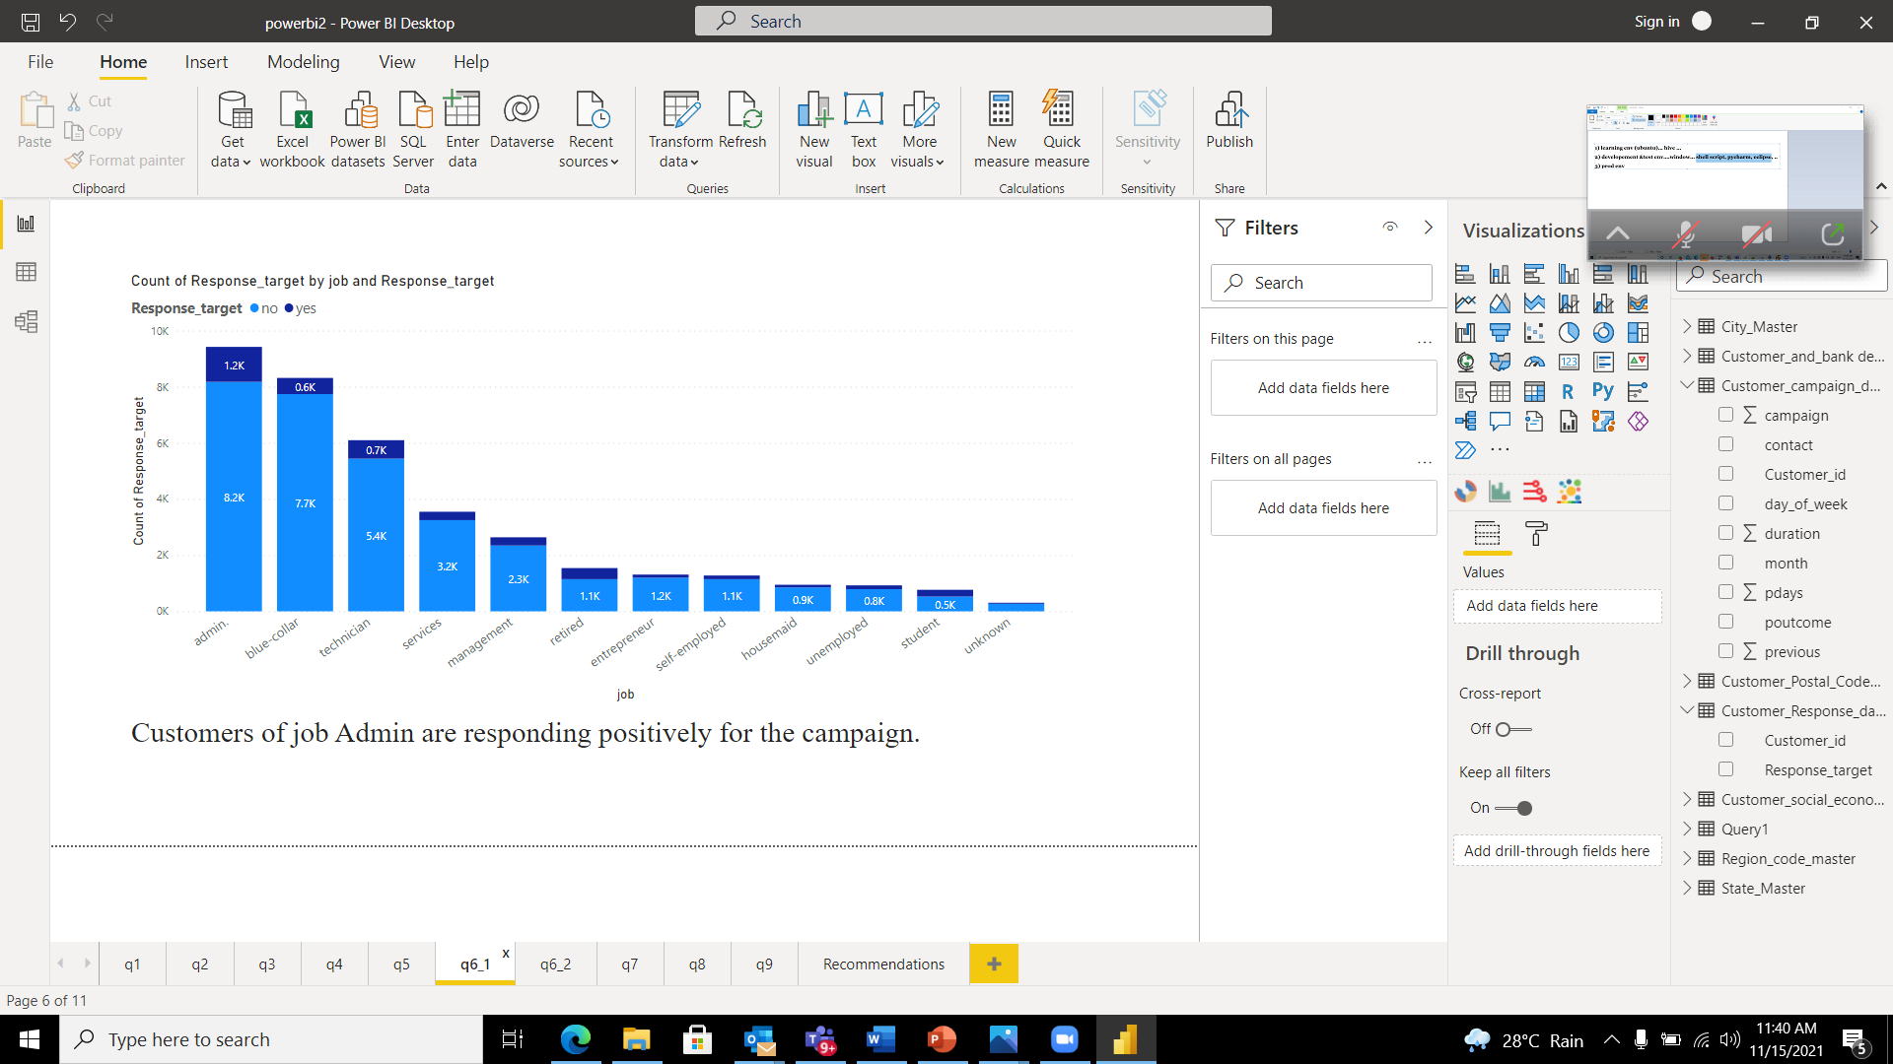
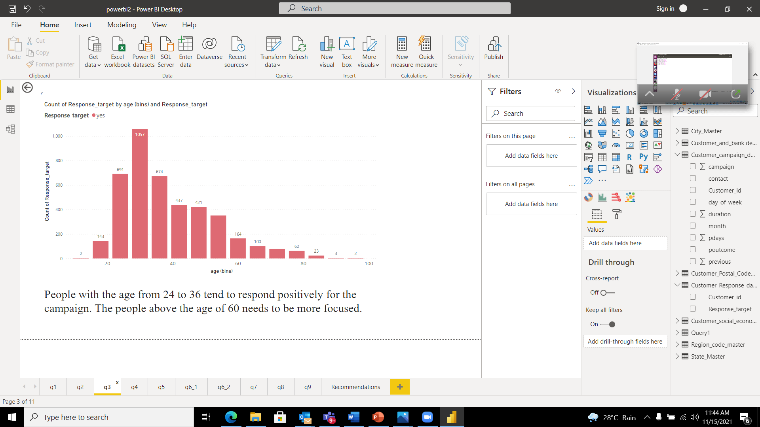
Task 2.3 – Visualization using Power-BI
Monthly Response
analysis
Bar plot for Response target and Job
Bar plot for Response target and Age
People with the age from 24 to 36 tend to respond positively for the campaign. This group needs to be more focused as there more customers in that age group.
The highest response month is May.
Customers of job Admin respond positively for the campaign.

Slide 32
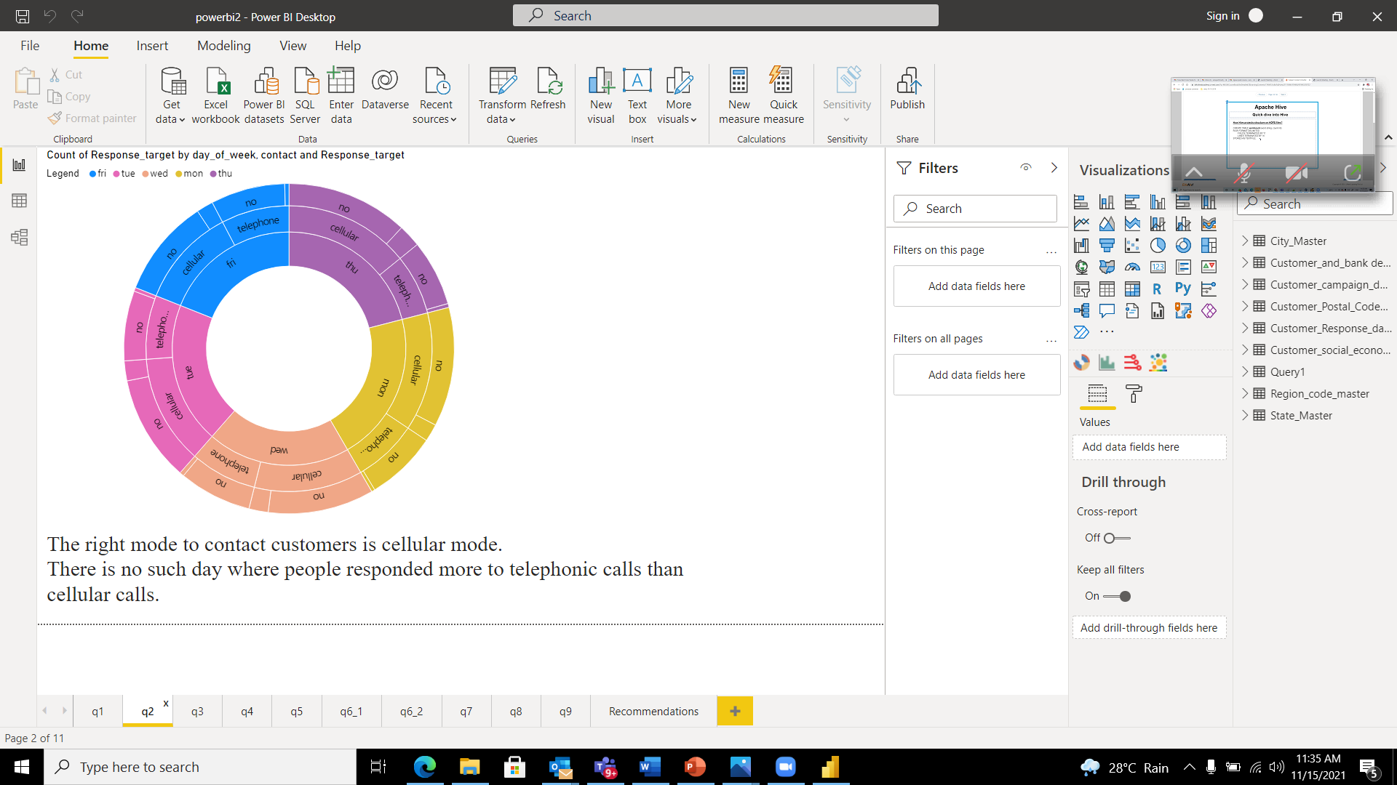
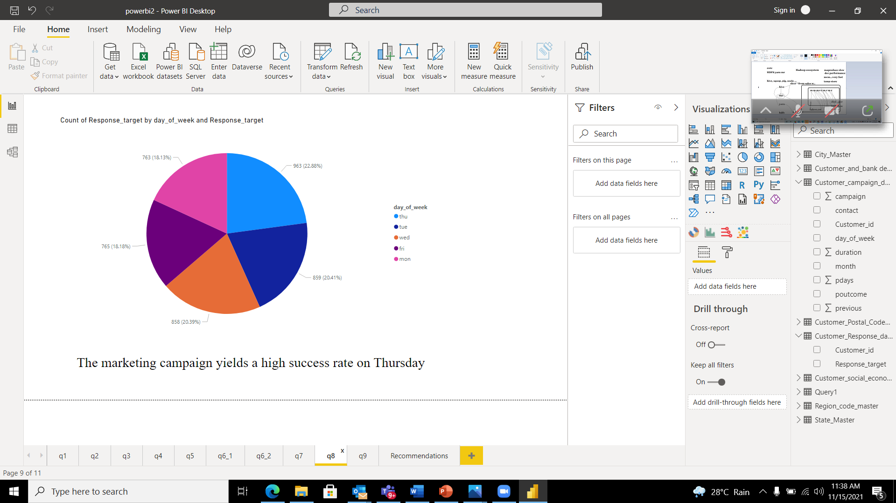
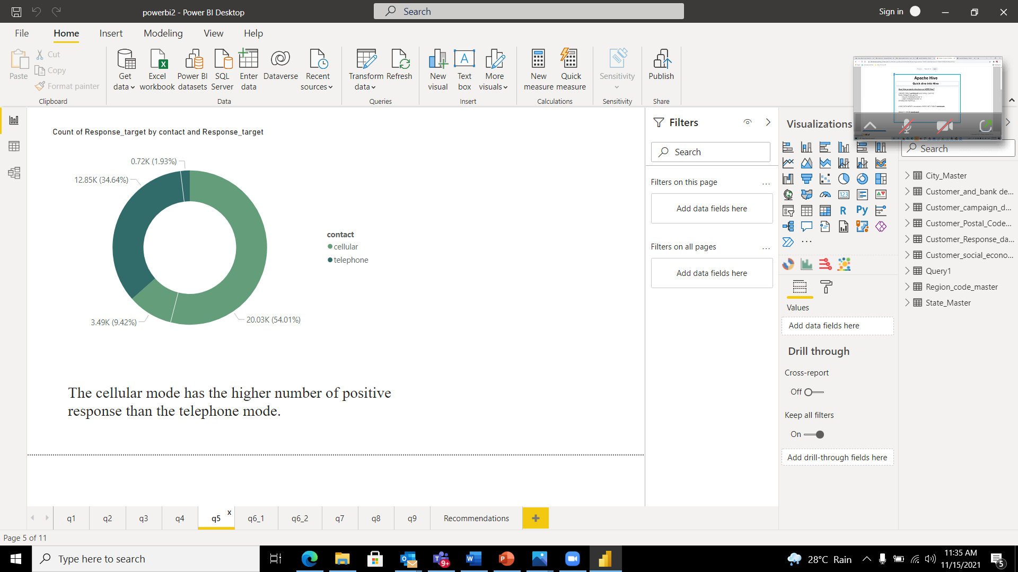
Visualization using Power-BI
Sunburst and Donut chart for the right mode to contact the customers
Pie Chart for Response target and Days of Week
The cellular mode has the higher number of positive responses than the telephone mode.
The marketing campaign yields a higher success rate on Thursday
The right mode to contact the customers is cellular mode.

Slide 33
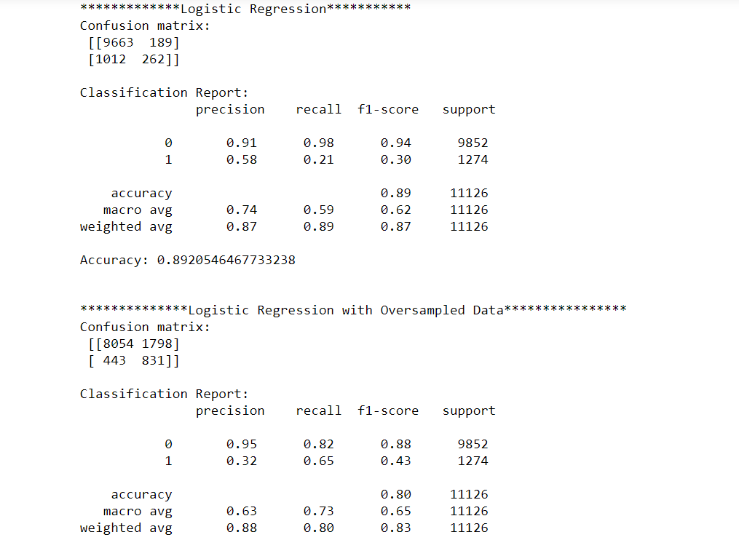
Task 2.4 – Model building using ML Algorithms: Logistic Regression Model:
The F1 score for class 0 is 94% and class 1 is 30%, then the model was oversampled and the new F1 score for class 0 is 88% and class 1 is 43%

Slide 34
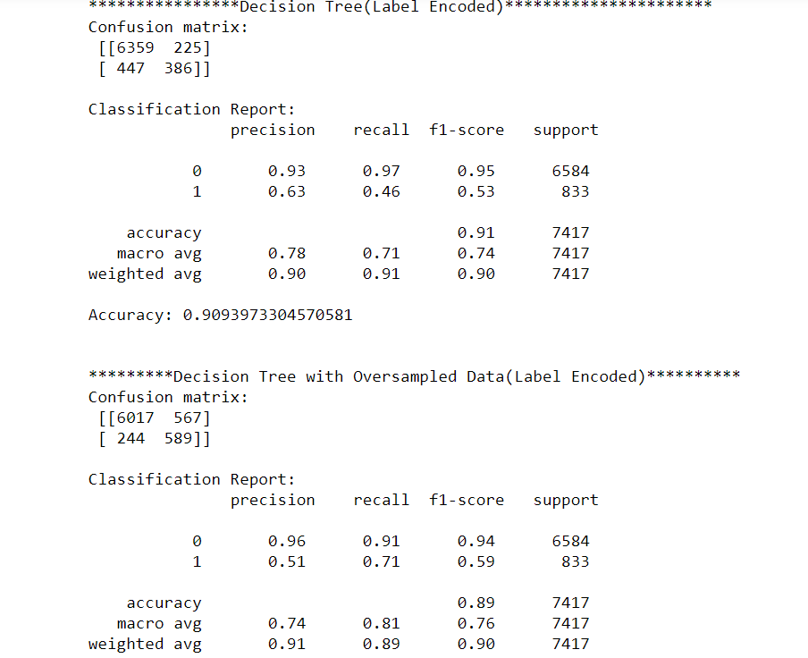
Decision Tree Model:
The F1 score for class 0 is 97% and class 1 is 53%, then the model was oversampled and the new F1 score for class 0 is 94% and class 1 is 59%

Slide 35
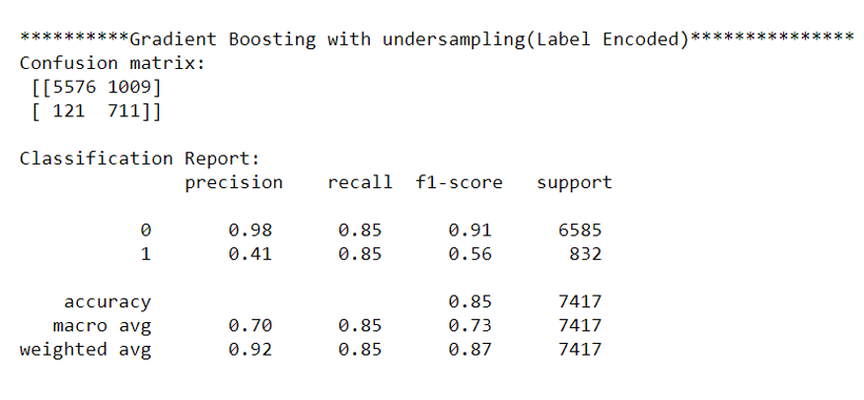
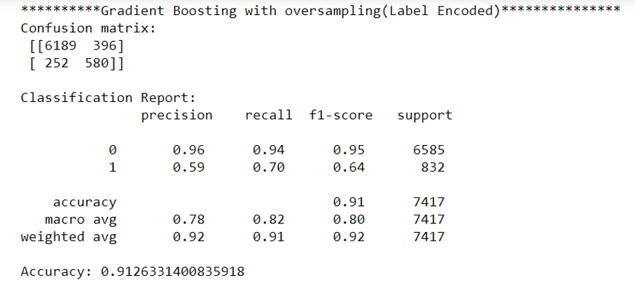
Gradient Boosting Model:
The F1 score for class 0 is 95% and class 1 is 64% with oversampling and the F1 score for class 0 is 91% and class 1 is 56% with oversampling

Slide 36
Inferences from model building:
The target of the dataset given was highly imbalanced, which resulted in poor training of the model. To overcome this issue, we tried oversampling and under-sampling to the training data.
We consider F1-score,recall and precision as a metric to evaluate the model because the target column is highly imbalanced and the score metric will not provide us proper conclusion.
Based on the analysis of different classifiers, the Gradient Boosting Classifier with oversampling provides best f1 score (95%,64%) among other classifiers. It also has higher recall (94%,70%) and precision (96%,59%) with an accuracy of 91% hence we choose this classifier as our Final Machine Learning Model.

Slide 37
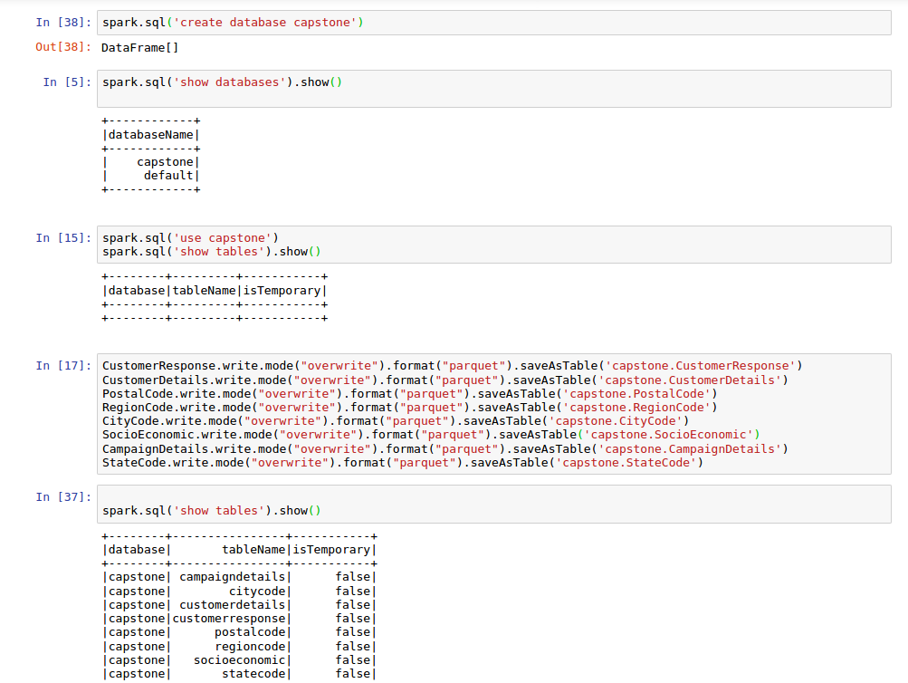
Task 3.1 – Data Analysis using Big Data Tools
The dataset was loaded into Spark DataFrame and was then loaded into Hive Tables in the optimal format (Parquet).

Slide 38
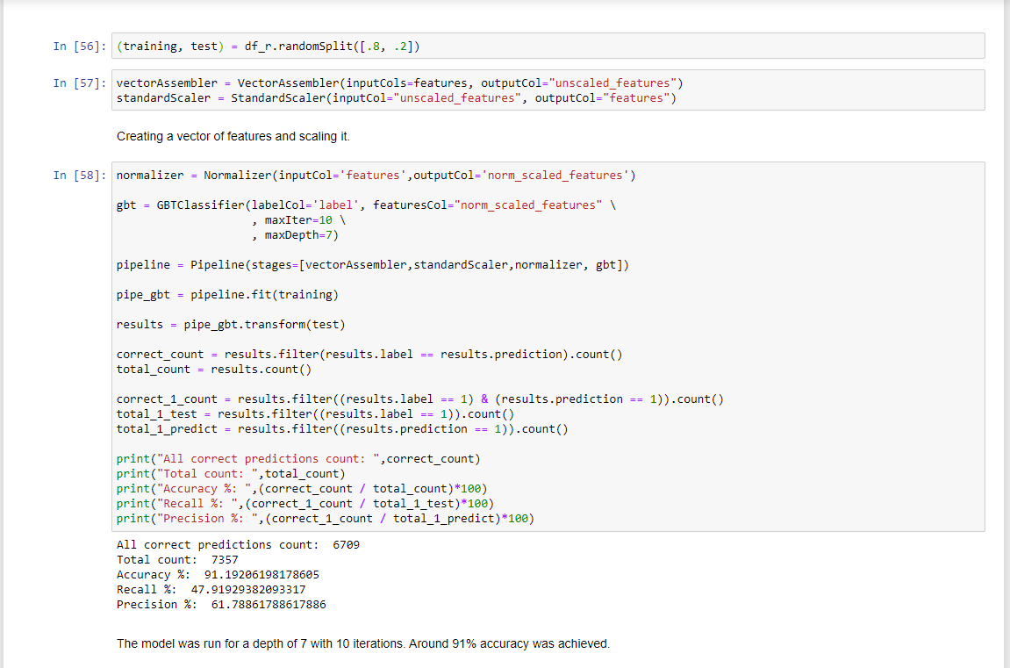
Task 3.1-Pyspark ML.lib
The data was split into training and testing (80,20) and was given to a pipeline of vector assembler , standard scale and normalization.
This was fed to a Gradient Boosting classifier (Chosen in task 2,4). The model had an accuracy of around 91%.

Slide 39
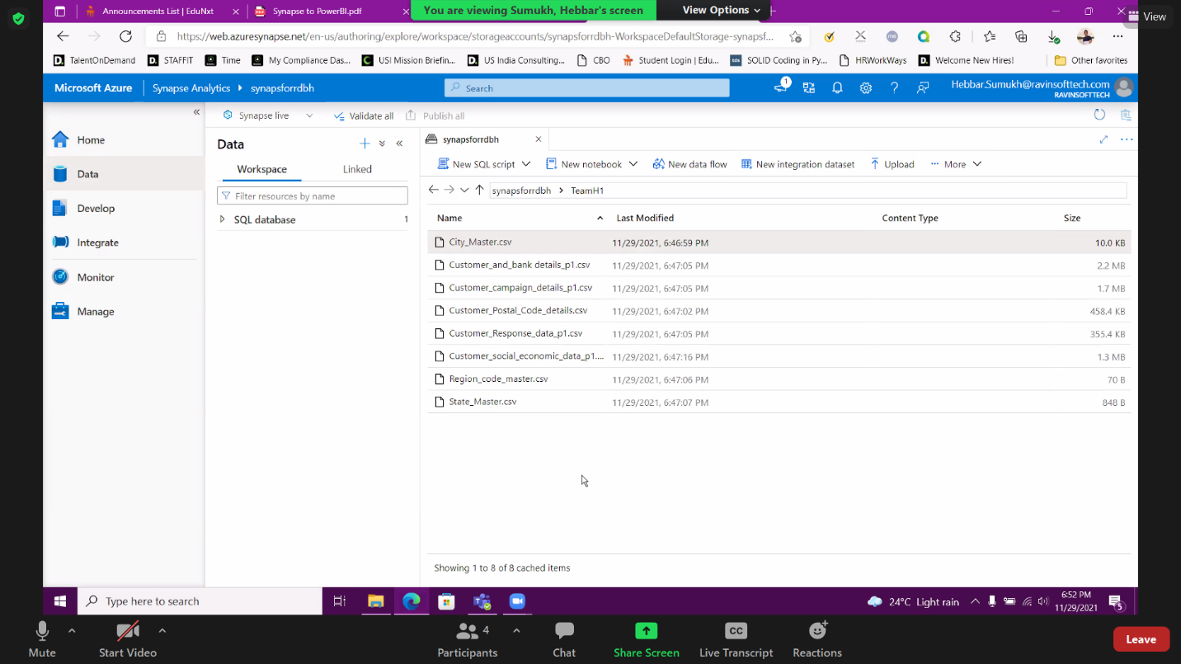
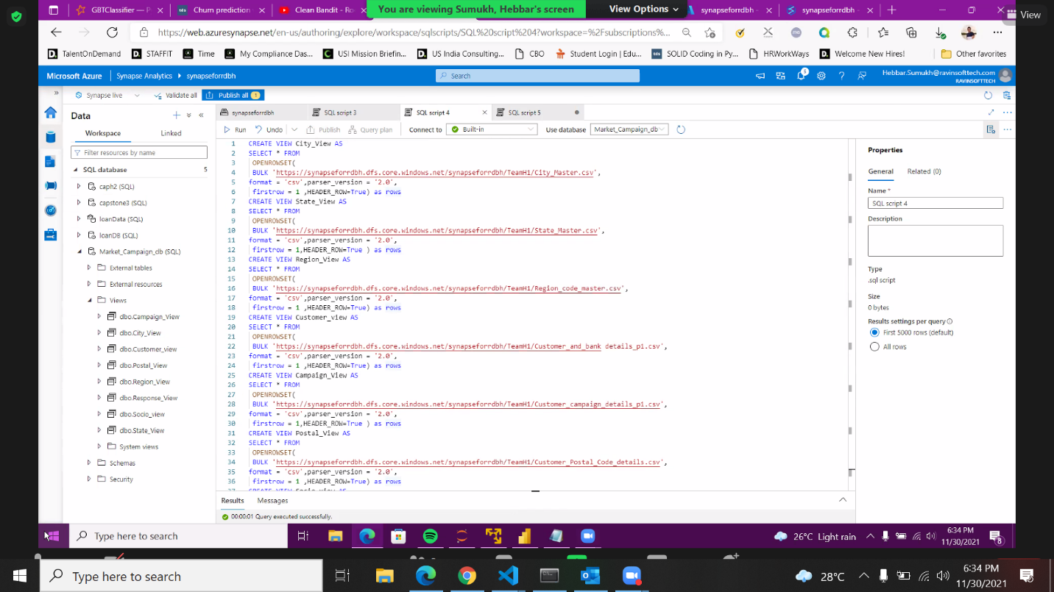
Task 3.2 – Data Analysis on Cloud
Created a folder with some valid name to upload your datasets to azure synapse storage Gen1
Created a serverless SQL pool to query the data from storage gen1 and create view tables

Slide 40
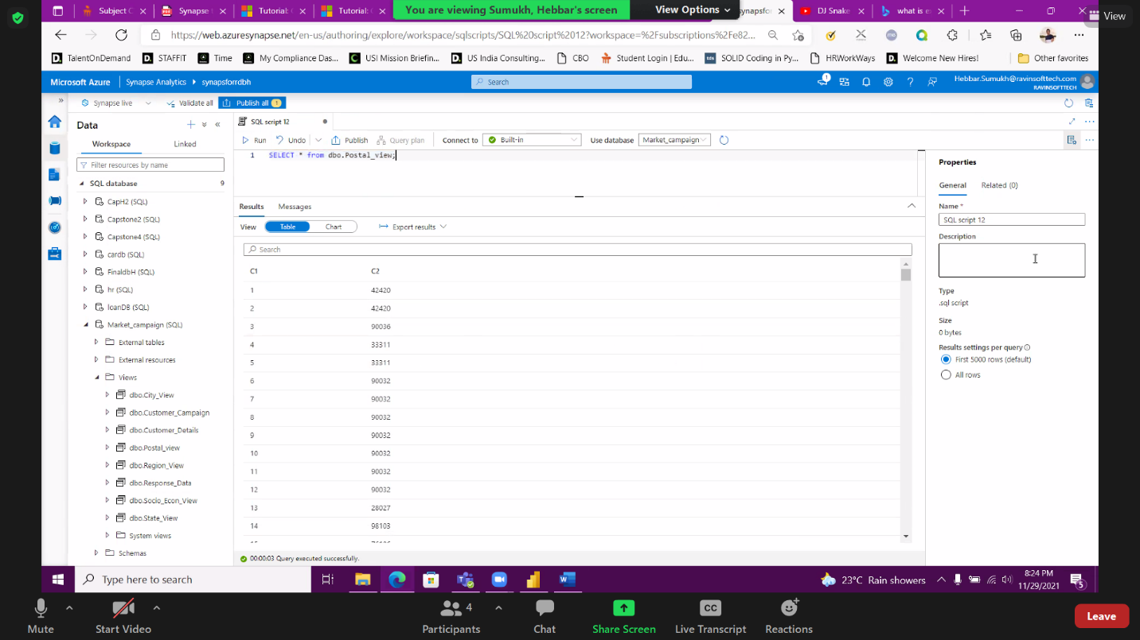
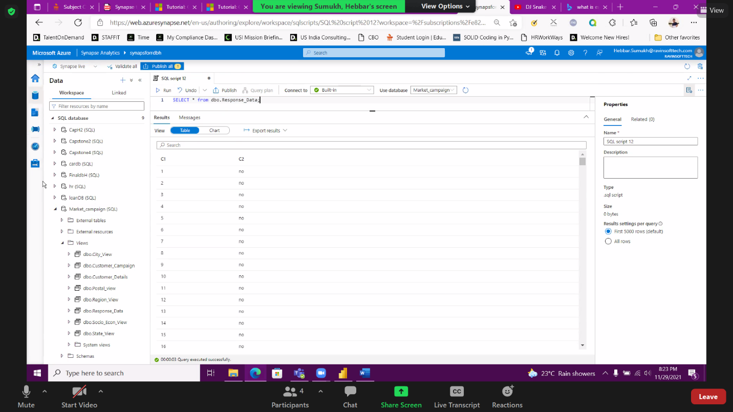
Checked the view created by writing select queries and saved all the tables

Slide 41
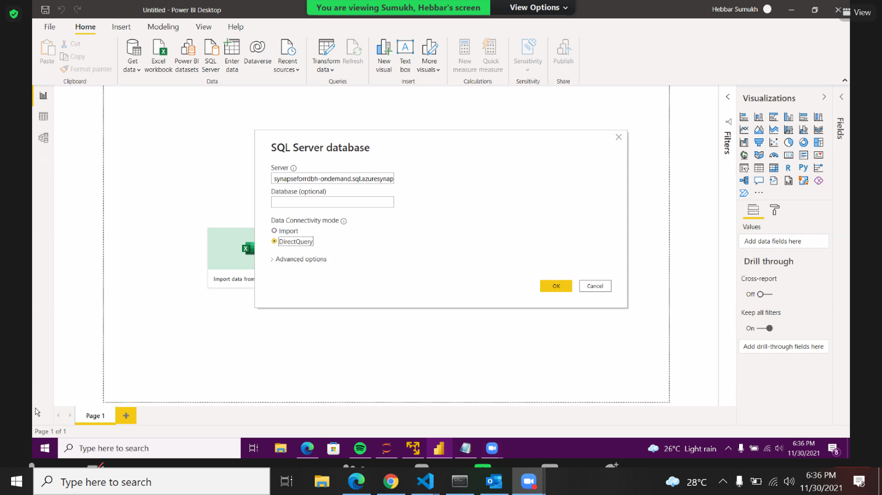
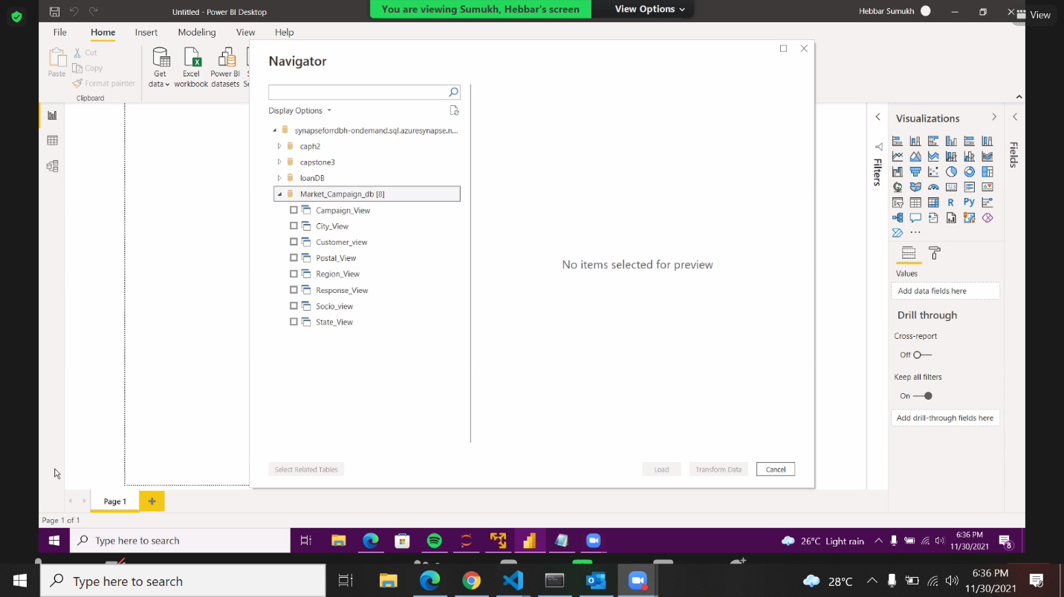
List of view tables in Power BI
Linking the Power BI to SQL Serverless database and viewing the list of view tables in Power BI
Provide Synapse- Serverless SQL endpoint and selected “Direct Query”

Slide 42
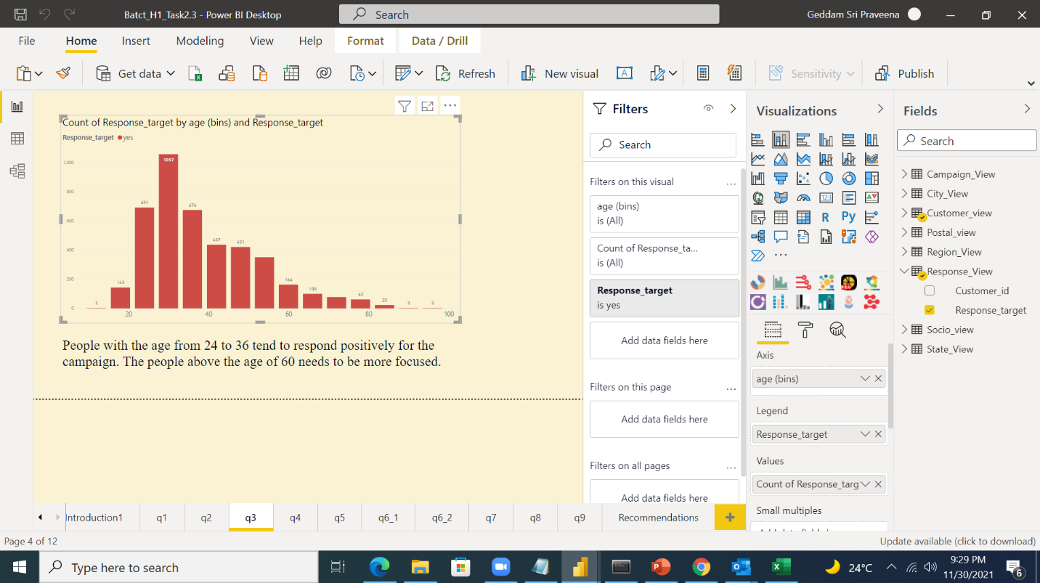

Various Analytics on Power BI
People with age group 24 to 36 tend to respond more
The right mode to contact the customers is the cellular mode

Slide 43


Thursday yields a high success rate
The highest number of response came from the customers who are having job and who are aving university degree

Slide 44


Task 3.3 – Deployment of Models using Flask

Slide 45



A data was tested on the model, and prediction was done
The webpage is given here.

Slide 46



A data was tested on the model, and prediction was done
The webpage is given here.

Slide 47

“We cannot quite know what will happen if a machine exceeds our own intelligence, so we can’t know if we’ll be infinitely helped by it, or ignored by it and sidelined, or conceivably destroyed by it..” ~Stephen Hawking

Slide 48


THANK YOU

